Slide 1
CHAPTER 2 – Part 3
Recurrence Relation
SCSI1013: Discrete Structures
2015/2016-Sem.1

Slide 2
Definition
A recurrence relation is an equation that defines a sequence {a_{n}, a_{n+1} , . . .} based on a rule that gives the next term as a function of one or more of the previous term in the sequence for all integers n with n≥ n₀ ,( )
A sequence is called a solution of a recurrence relation if it terms satisfy the recurrence relation.

Slide 3
Simple Recurrence Relation
The simplest form of a recurrence relation is the case where the next term depends only on the immediately previous term.
3, 8, 13, 18, 23, . . .
The above sequence shows a pattern, given initial condition, a₁ =3:
3, 3+5, 8+5, 13+5, 18+5, . . .
generated from an equation:

Slide 4
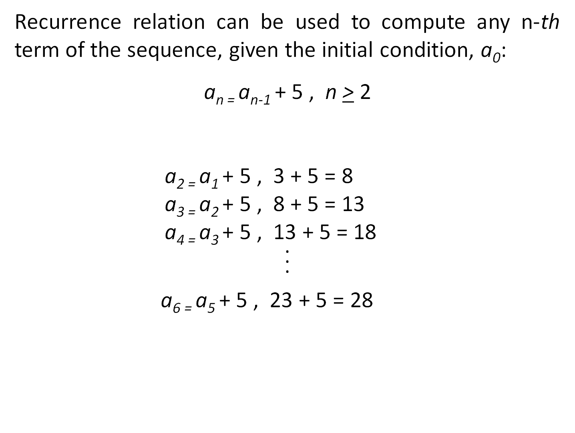
n_{th} term of a sequence
3, 8, 13, 18, 23, 28, , . . .

Slide 5
Example 1
Consider the following sequence:
3, 9, 27, 81, 243, . . .
The above sequence shows a pattern:
3¹, 3², 3³, 3⁴, 3⁵, . . .
Recurrence relation is defined by:

Slide 6
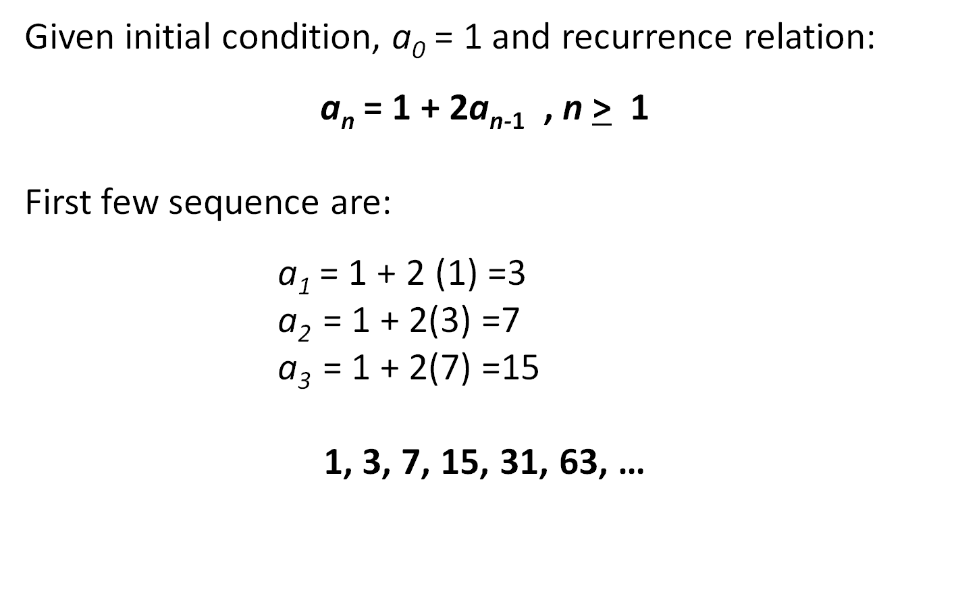
Example 2

Slide 7
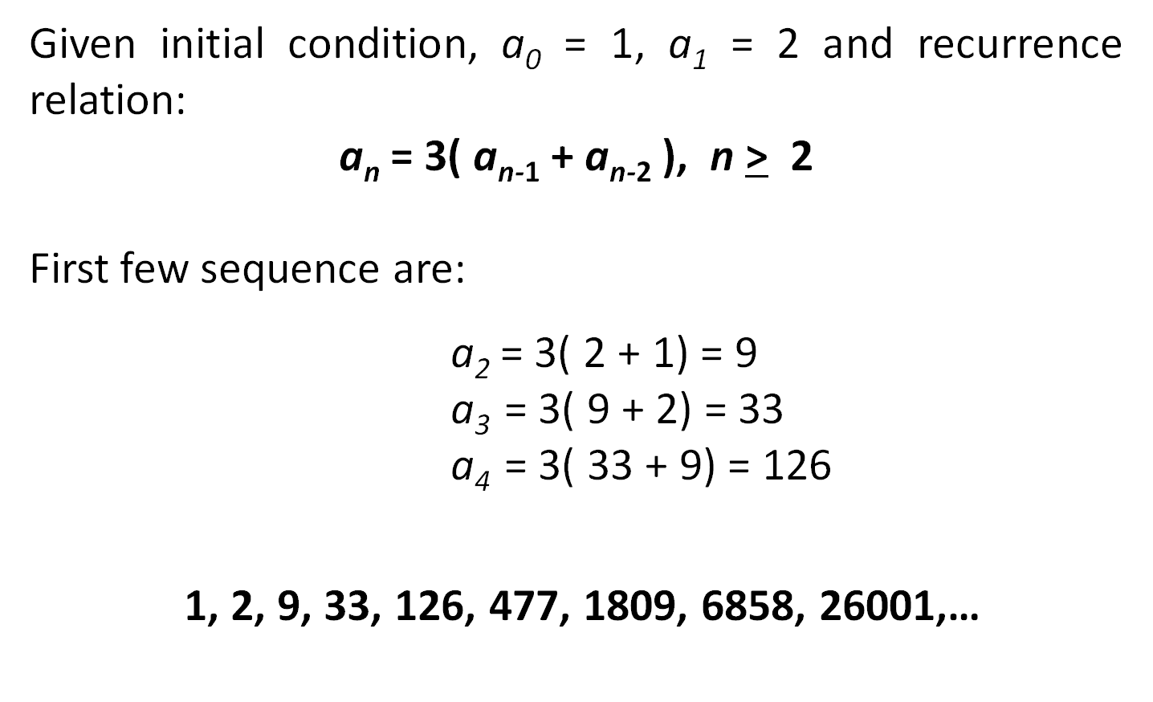
Example 3

Slide 8
Exercise
a_{n} = 6a_{n−1} − 9a_{n−2} , where a₀ =2, a₁ =3
a_{n} =2a_{n−1} −a_{n−2} , where a₀ =5, a₁ =3

Slide 9
Example 4
For a photo shoot, the staff at a company have been arranged such that there are 10 people in the front row and each row has 7 more people than in the row in front of it. Find the recurrence relation and compute number of staff in the first 5 rows.

Slide 10
Example 4 -Solution
Notice that the difference between the number of people in successive rows is a constant amount.
This means that the n_{th} term of this sequence can be found using:
a_{n} = a_{n-1}+ 7, n > 2 with a₁ = 10

Slide 11
Example 4 -Solution
Number of staff in the first 5 rows:
      a₁ = 10 ,
      a₂ = a₁ + 7, 10 + 7 = 17
      a₃ = a₂ + 7, 17 + 7 = 24
      a₄ = a₃ + 7, 24 + 7 = 31
      a₅ = a₄ + 7, 31 + 7 = 38
      10, 17, 24, 31, 38

Slide 12
Example 5
Find a recurrence relation and initial condition for
1, 5, 17, 53, 161, 485, …
Solution:
Look at the differences between terms:
4, 12, 36, 108, …
The differences in the sequence is growing by a factor of 3

Slide 13
Example 5 -Solution
However the original sequence is not.
1(3)=3, 5(3)=15,17(3)=51, . . .
1, 5, 17, 53, 161, 485, …
It appears that we always end up with 2 less than the next term.
So, the recurrence relation is defined by:
a_{n} = 3( a_{n-1} ) + 2, n > 1, with initial condition, a₀ = 1

Slide 14
Example 6
A depositor deposits RM 10,000 in a savings account at a bank yielding 5% per year with interest compounded annually. How much money will be in the account after 30 years? Let P_{n} denote the amount in the account after n years.

Slide 15
Example 6 - Solution
Derive the following recurrence relation:
P_{n} = P_{n-1} + 0.05P_{n-1} = 1.05P_{n-1}
Where, P_{n} = Current balance and P_{n-1} = Previous year balance and 0.05 is the compounding interest.

Slide 16
Example 6 - Solution
Initial condition, P₀ = 10,000. Then,
    P₁ = 1.05P₀
    P₂ = 1.05P₁ = (1.05)²P₀
    P₃ = 1.05P₂ = (1.05)³P₀
    …
    P_{n} = 1.05P_{n-1} = (1.05)^{n}P₀ ,
    now we can use this formula to calculate n_{th} term without iteration

Slide 17
Example 6 - Solution
Let us use this formula to find P₃₀ under the
initial condition P₀ = 10,000:
P₃₀ = (1.05)³⁰(10,000) = 43,219.42
After 30 years, the account contains RM 43,219.42.

Slide 18
Exercise
Consider the following sequence:
1, 5, 9, 13, 17
Find the recurrence relation that defines the above sequence.
Answer:
a_{n} = a_{n -1} + 4 , n > 2 with a₁ = 1

Slide 19
Exercise
A basketball is dropped onto the ground from a height of
15 feet. On each bounce, the ball reaches a maximum height 55% of its previous maximum height.
Write a recursive formula, a_{n} , that completely defines the height reached on the n_{th} bounce, where the first term in the sequence is the height reached on the ball's first bounce.
How high does the basketball reach after the 4_{th} bounce? Give your answer to two decimal places.

Slide 20
Answer
Recurrence relation:
a_{n} = 0.55 a_{n-1} , n > 2 , with a₁ = 8.25 feet
a₂ = 4.54 feet
a₃ = 2.50 feet
a₄= 1.37 feet
The basket ball reached 1.37 feet after fourth bounce

